Slide 1

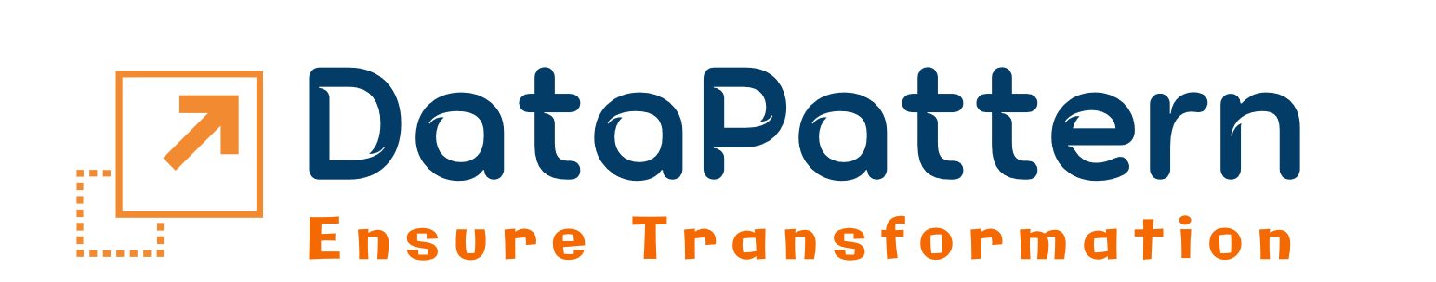
Elevating Augment Generation with Enhanced Response Quality
DataPattern with retrieval argument generation
Notes:
Exploring 'Retrieval Augmented Generation': combining retrieval techniques with generation for enhanced data output.

Slide 2

Slide Content
Introduction
Benefits
Path of RAG
Architecture of RAG
RAG Essence Unveiled
Customer Stories – Case study
Upcoming Technologies
Notes:
Overview of presentation topics: Introduction, Path of RAG, RAG essence, Upcoming Technologies, Benefits, RAG Architecture, and Customer Stories.

Slide 3










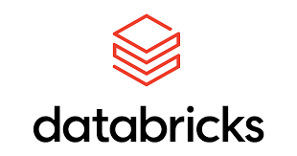
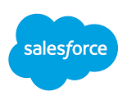




Introduction -DataPattern
We help Move your Digital Transformation Vision to Reality
Special Start-up Ecosystem
Clients
Connecting Companies to Start-up products
Assist identify your right product (Data, IoT)
Unique approach & Successful engagements
Major Energy company in US
Major Payments company in US
Major Telecom clients in Canada
France based technology service provider
India based Consulting firm
Diversified & Specialized
Domains
Woman empowered organization
125+ Team members
Data focused view for Dx initiatives
Industrial Expertise / Specialized skills
Hybrid options – Onshore/ Near Shore
Hi Tech
Energy & utilities
Manufacturing
Banking and Financial Services
Global Presence
Partners/Alliances
US / Canada / India
Notes:
Introduction to DataPattern: Overview of partners, clients, global presence, and specialized domains, showcasing the company's diversified expertise and global reach.

Slide 4

Digital Transformation Services Portfolio
We help Move your Digital Transformation Vision to Reality
Advisory and Consulting Services
Banking & FinTech Solutions
Manufacturing Solutions
EV Solutions
Energy Solutions
Application Development
Dev Ops
ML Ops
Sec Ops
Integration
IoT/IIoT Solutions
Data Sciences
GenAI
Solutions
Cloud Solutions
Product Engineering
Migration
Support and Managed Services
Data Management / Data Platforms
Master Data/ Reference Data management
Data Quality
Data Engineering
Data Integration
Data Privacy & Governance
Data Architecture
Testing & QA
Notes:
Detailing DataPattern's service offerings, encompassing a range of solutions tailored to meet diverse client needs and industry requirements.

Slide 5

Traversing the Path of Retrieval Augmented Generation
"RAG framework enhances responses by retrieving data from external knowledge sources."
User
Prompt
Search relevant information
Data enhances context.
Processing the context
Data
Send to user
API
Requested
Knowledge source
Requested to LLM end point
Fresh, quality data created
External sources : Scouring pertinent data from external reservoirs.
Data Sources
Various repositories providing relevant information for retrieval.
1
2
Online Sources
Diverse web-based platforms offering valuable data.
3
Application programming interface
Software intermediary enabling communication between different applications.
4
External Databases
External repositories storing structured data for retrieval.
5
Digital Libraries
Repositories of digital content, such as books and articles.
6
Social media platforms
Online platforms for user-generated content and interaction.
Notes:
Introduction to RAG (Retrieval Augmented Generation), including its process flow and utilization of external sources to enhance text generation capabilities.

Slide 6
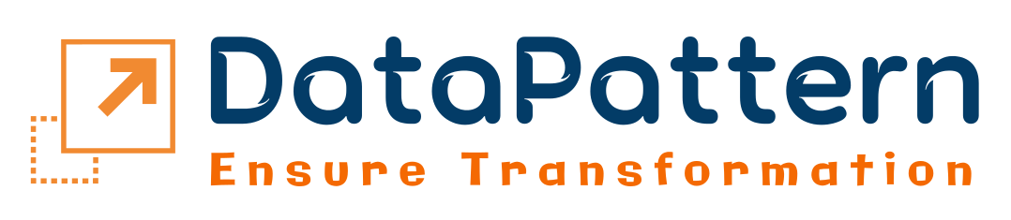
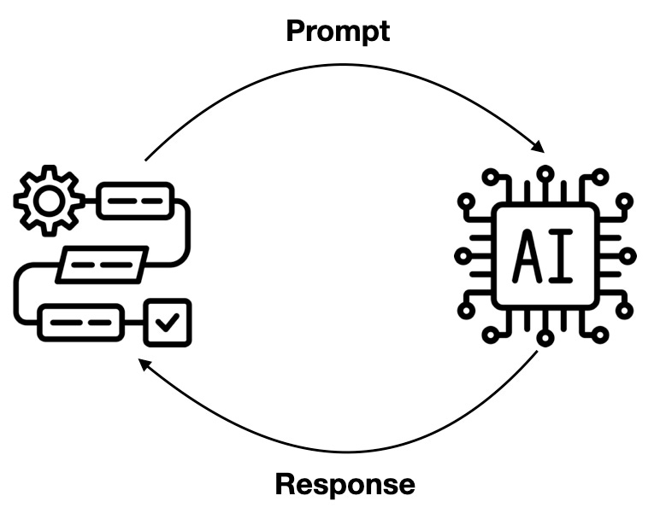
RAG Essence Unveiled
"We leverage diverse external sources for updated data and superior responses."
Core Functionalities
Integration Capabilities
User Prompt
Context send to LLM model
System Integration
API Compatibility
API requested to external source
LLM synthesis the data of context
Customization Capabilities
API Model
Integrations
We provide enhanced data sourced for optimal performance.
+
External sources
Search relevant data context
Precise data send to user
Real-time Integration
Scalability Options
Notes:
Highlighting the core functionalities of RAG and its integration capabilities, showcasing its versatility and adaptability within various contexts and systems.

Slide 7

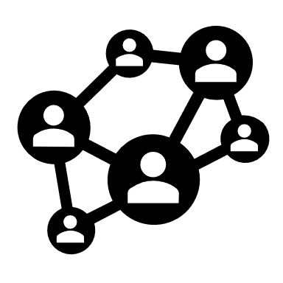







Benefits
Current Information
Simplified Training
Versatile Applications
Reduced Hallucinations
Cost Savings
Information Synthesis
User Trust
Notes:
Detailing the numerous benefits of RAG, emphasizing its capacity to improve text generation efficiency, accuracy, and relevance, ultimately enhancing overall workflow and output quality.

Slide 8
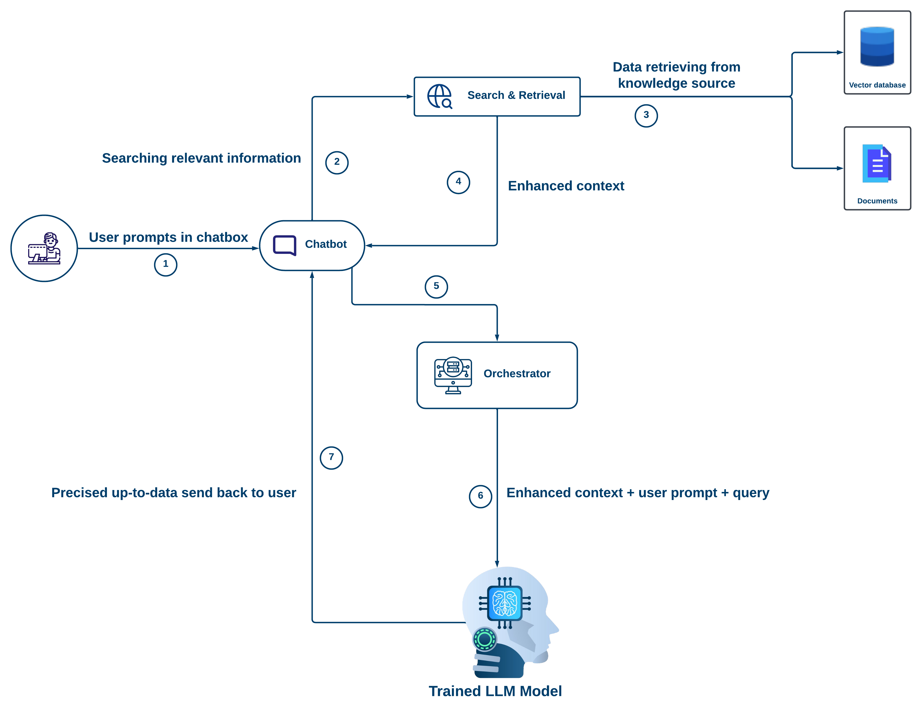
Architecture of RAG
How Retrieval Augmented Generation Works
Notes:
Presenting the architecture flow chart of RAG, illustrating the structural framework and key components that facilitate its retrieval-augmented text generation process.

Slide 9
Customer Stories – Case study
EminenceAI is a RAG based web application which generates questions using RAG LLM model.
When a faculty member initiates the "Build" action, an API call is made to Eminence AI's core.
A request ID is generated for tracking.
Questions based on input are produced and stored in an Eminence AI-controlled database.
Generated questions are sent back to the main application database and rendered for faculty review.
Core
Applications
Generate questions
API call to core
Question build request
Generates question in background
Question display to user
Question send to application
Question stored in database
Notes:
Illustrating a customer success story through the 'EminenceAI' project, showcasing real-world implementation and the tangible benefits derived from utilizing RAG within the context of a specific project.

Slide 10

EminenceAI (Case Study) #7
DataPattern builds a web application for EminenceAI, dynamic medical education exam platform.
Challenges
Approach and Solution
Results
Medical students find exams challenging, struggling to access questions effectively.
Institutions neglect student training, lacking proper provision of sample question sets.
Students face difficulty navigating extensive syllabus without breaking it into manageable sections.
Easy filtration : Filtering syllabus using multiple fields like subject, system, sub-system etc.,
QGen for faculty : Faculty efficiently trains students with unlimited questions by providing curated sets.
Vetted questions: Students access regularly updated questions and answers from a vetted database during exams.
Vetters can effortlessly review questions by logging into the application.
Students can self-train with timed and tutor mode tests, and invite friends for discussions.
Faculty can seamlessly generate questions from the core, facilitating review and download.
Displaying student performance accurately reflects syllabus comprehension and strengths.
Notes:
Detailing challenges, approach, solutions, and results of the 'EminenceAI' project, showcasing RAG's effectiveness in overcoming obstacles and delivering impactful outcomes.

Slide 11



Capabilities of DataPattern
Unleashing insights through Databricks, Gen AI, and Power BI
Databricks
Model Deployment : Deploy trained models on Databricks for efficient retrieval and generation tasks.
Model training : Train big models fast on Databricks with distributed computing.
Data Integration : Databricks integrates various data sources for retrieval and generative models.
Power BI
Visualization of Retrieved Information: Power BI visualizes retrieved data, improving understanding and interpretation.
Integration with AI Services: Power BI integrates AI services for enhanced analytics and natural language generation, enriching retrieved information.
Natural Language Queries: Power BI's language processing enables simple queries for interactive exploration.
Gen AI
Content Creation: GenAI augments retrieved information by creating new content from learned patterns.
Diverse Outputs: GenAI provides varied outputs for exploring different perspectives or content variations.
Enhanced Understanding : GenAI enhances understanding with added context, making information clearer and more actionable.
Notes:
Highlighting DataPattern's capabilities in RAG, including expertise in platforms like Databricks, GEN AI, and Power BI, showcasing its proficiency in leveraging diverse technologies to enhance text generation processes.

Slide 12
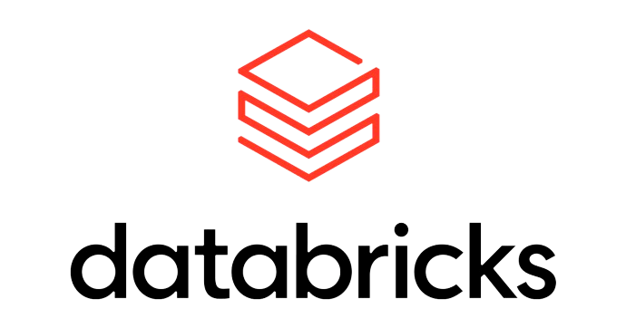
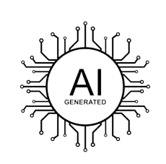
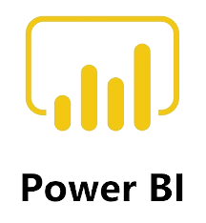
What can we do in RAG?
Databricks facilitates seamless integration of retrieval mechanisms with generation models, enhancing the contextuality and relevance of generated responses.
Databricks fosters iterative improvements in retrieval-augmented generation models through efficient collaboration and experimentation.
Gen AI models can generate human-like responses based on retrieved information, enriching the contextuality and relevance of the generated content.
Gen AI's adaptability allows for personalized augmentation, tailoring responses to user preferences or real-time data, enhancing the overall user experience.
Power BI can visualize retrieved information and generated responses, providing stakeholders with intuitive insights into the augmentation process.
Power BI's integration capabilities enable the incorporation of external NLP tools or models, enriching retrieval-augmented generation workflows with additional analytical power.
Notes:
Detailing the possibilities and capabilities within RAG, showcasing the range of applications and potential outcomes achievable through its utilization.

Slide 13
RAG based services
Custom AI Solutions
Data Integration
Advanced Analytics
Tailored AI for specific needs.
Precision AI solutions for efficiency.
Customized intelligence to drive innovation.
Natural Language Queries
Merge diverse data seamlessly.
Integrate various sources for clarity.
Combine data for comprehensive insights.
Big Data Processing
Dive deep for valuable insights.
Uncover trends with predictive analytics.
Extract insights from complex data..
Simple questions for quick answers.
Everyday language for intuitive search.
Plain language queries for understanding.
Efficiently handle vast data volumes.
Process large datasets with ease.
Scale for massive data processing.
AI-driven Decision Support
Consultation & Training
Automated Reporting
Intelligent insights for informed decisions.
Recommendations based on predictive analysis.
AI-guided choices for strategic planning.
Expert guidance for effective implementation.
Tailored training for optimal usage.
Generate reports automatically for efficiency.
Streamline reporting processes with automation.
Simplify reporting tasks with automation.
Notes:
Detailing RAG-based services offered by DataPattern, encompassing custom AI solutions, natural language queries, data integrations, and big data processing, showcasing the breadth of capabilities in leveraging RAG for various applications.

Slide 14
Upcoming Technologies
Retail and Consumer Engagement
Continuous Adaptation
Industrial Digitalization
Active Retrieval Strategies
Healthcare and Anomaly Detection
Enhancing Domain Adaptation
Use Cases
Challenges and Limitations
Notes:
Exploring future technologies in RAG, showcasing upcoming innovations and advancements.

